Slide 1
Growing a Streaming Service Microsoft
Han & Jeff

Slide 2


AGENDA
INTRODUCTION
PRIMARY GOALS
Data exploration
Visualizations
SUMMARY

Slide 3

INTRO
Data Sources:
IMDB
The-Numbers.com
The Movie Database

Slide 4
Primary Goal
Creating a successful streaming service
Measures of success?

Slide 5


Measures of success
$
Profitability
ROI
Growth and Synergy
Each project maximizing earnings
Maximizing earnings per dollar-spend on production
Maximizing user engagement
Promoting Microsoft’s other offerings

Slide 6
Most profitable films
Blockbuster type films
Maximizes the earnings per film
Good returns while still maximizing reach

Slide 7
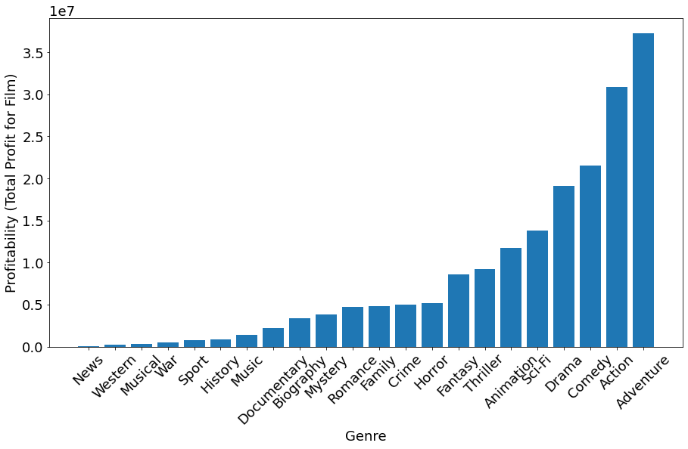
Average Profitability by Genre

Slide 8
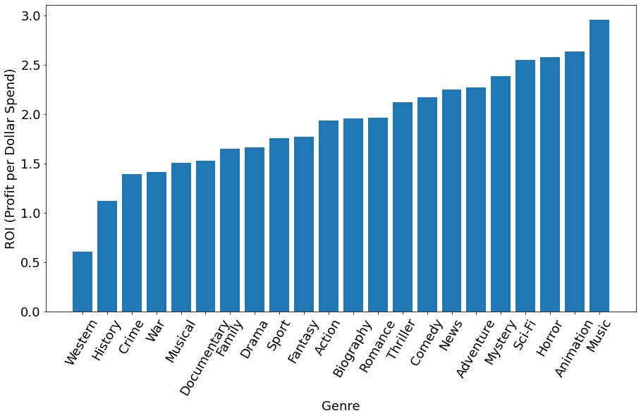
Average ROI by Genre

Slide 9
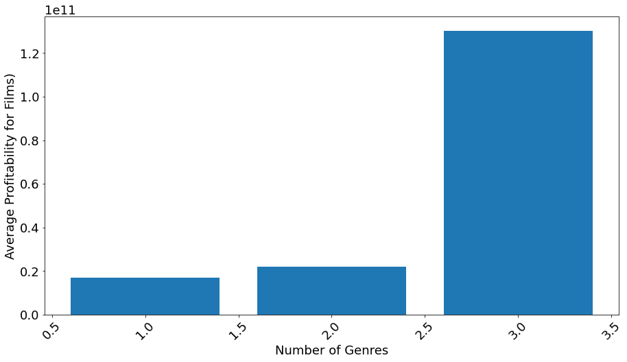
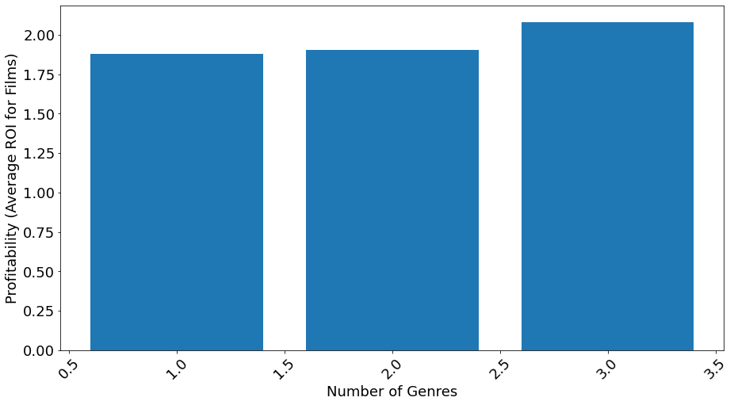
Returns by number of genres
Profitability by number of genres
ROI by number of genres

Slide 10
AREAS OF GROWTH
 | B2B | Supply chain | ROI | E-commerce
Q1 | 4.5 | 2.3 | 1.7 | 5.0
Q2 | 3.2 | 5.1 | 4.4 | 3.0
Q3 | 2.1 | 1.7 | 2.5 | 2.8
Q4 | 4.5 | 2.2 | 1.7 | 70

Slide 11




MEET OUR TEAM
Takuma
Hayashi
Mirjam
Nilsson
Flora
Berggren
Rajesh Santoshi
President
Chief Executive Officer
Chief Operations Officer
VP Marketing

Slide 12








MEET OUR EXTENDED TEAM
Takuma Hayashi
Mirjam Nilsson
Flora Berggren
Rajesh Santoshi
President
Chief Executive Officer
Chief Operations Officer
VP Marketing
Graham Barnes
Rowan Murphy
Elizabeth Moore
Robin Kline
VP Product
SEO Strategist
Product Designer
Content Developer

Slide 13
PLAN FOR PRODUCT LAUNCH
Deploy strategic networks with compelling e-business needs
PLANNING
Synergize scalable e-commerce
MARKETING
Disseminate standardized metrics
DESIGN
Coordinate e-business applications
Foster holistically superior methodologies
LAUNCH
STRATEGY

Slide 14
TIMELINE
SEP 20XX | Synergize scalable e-commerce
NOV 20XX | Disseminate standardized metrics
JAN 20XX | Coordinate e-business applications
MAR 20XX | Foster holistically superior methodologies
MAY 20XX | Deploy strategic networks with compelling e-business needs

Slide 15




AREAS OF FOCUS
B2B MARKET SCENARIOS
Develop winning strategies to keep ahead of the competition​
Capitalize on low-hanging fruit to identify a ballpark value​
Visualize customer directed convergence
CLOUD-BASED OPPORTUNITIES
Iterative approaches to corporate strategy​
Establish a management framework from the inside

Slide 16

SUMMARY
At Contoso, we believe in giving 110%. By using our next-generation data architecture, we help organizations virtually manage agile workflows. We thrive because of our market knowledge and great team behind our product. As our CEO says, "Efficiencies will come from proactively transforming how we do business."

Slide 17
THANK YOU
Mirjam Nilsson
mirjam@contoso.com
www.contoso.com

